Slide 1
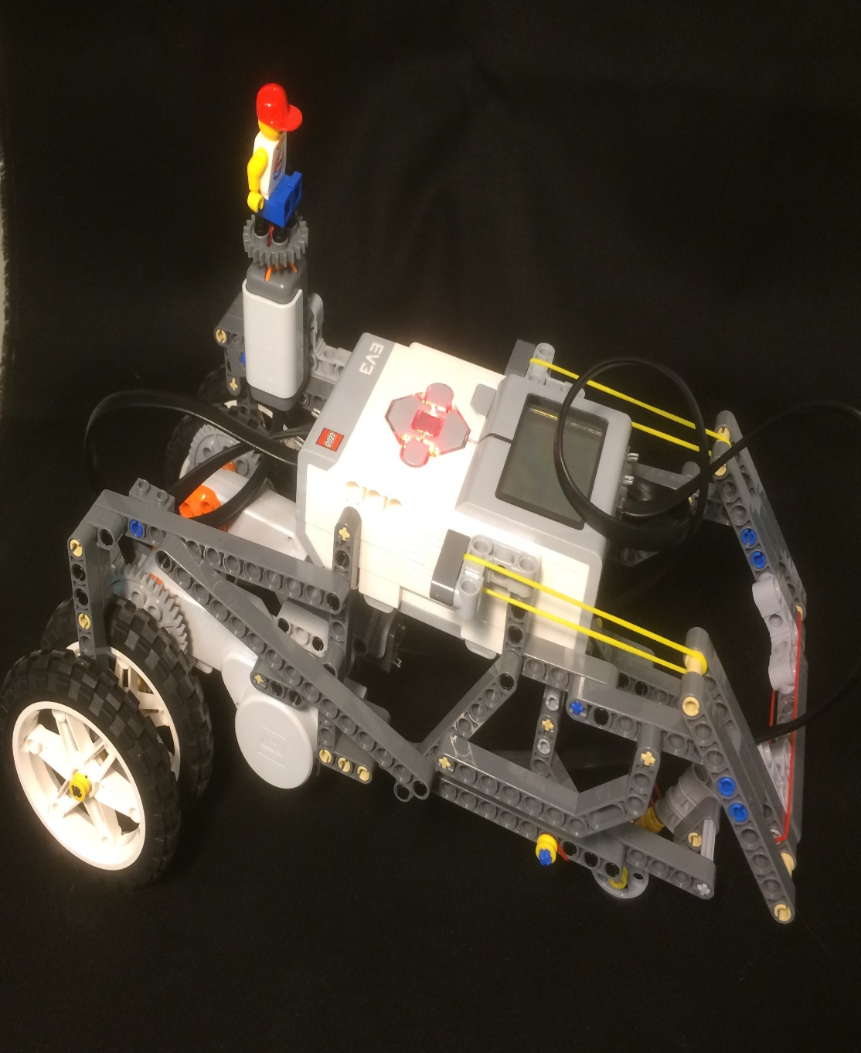
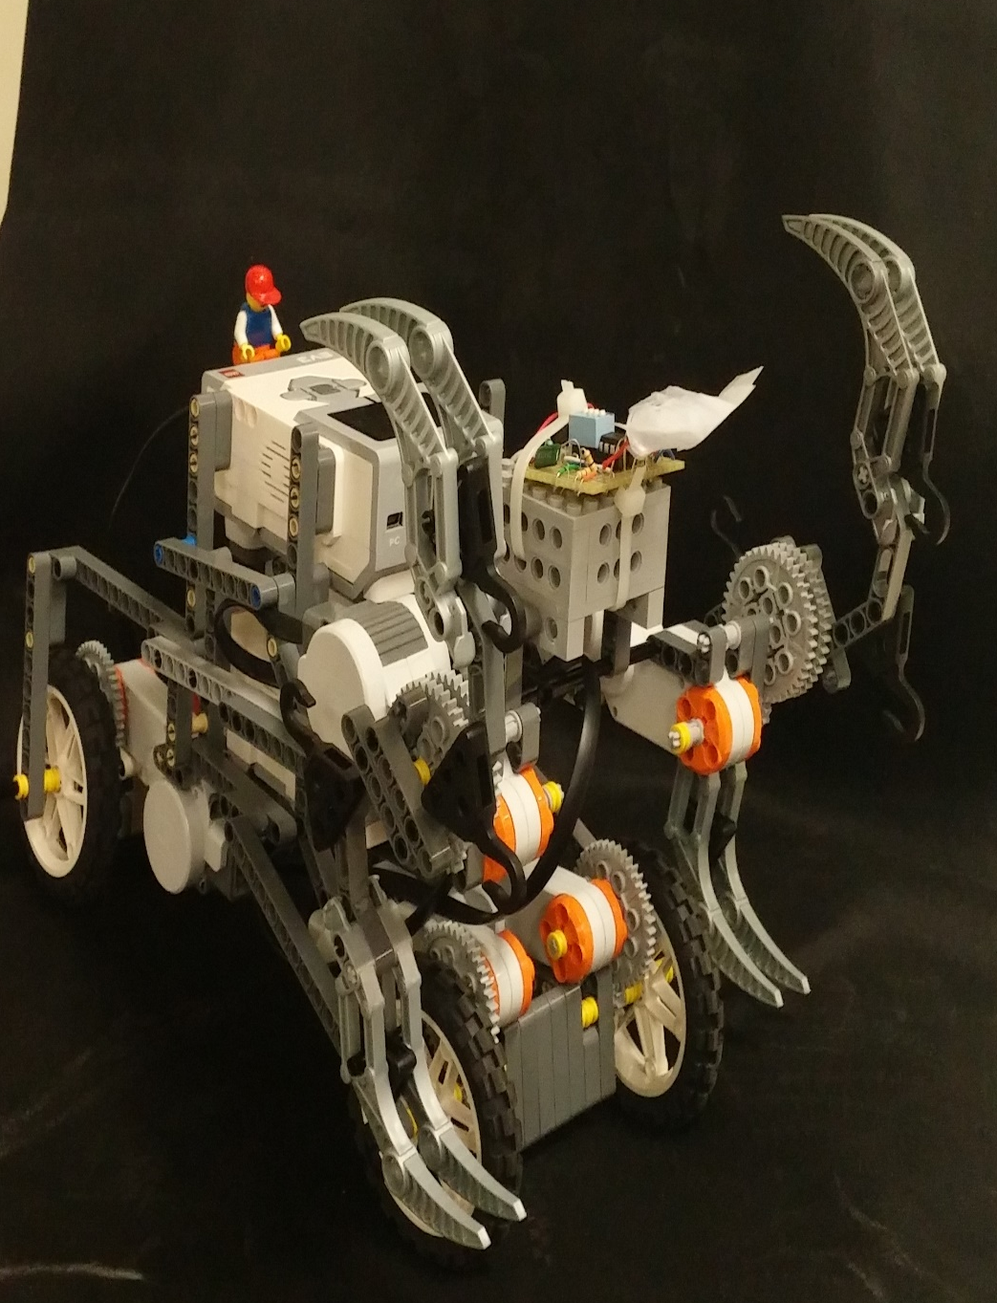
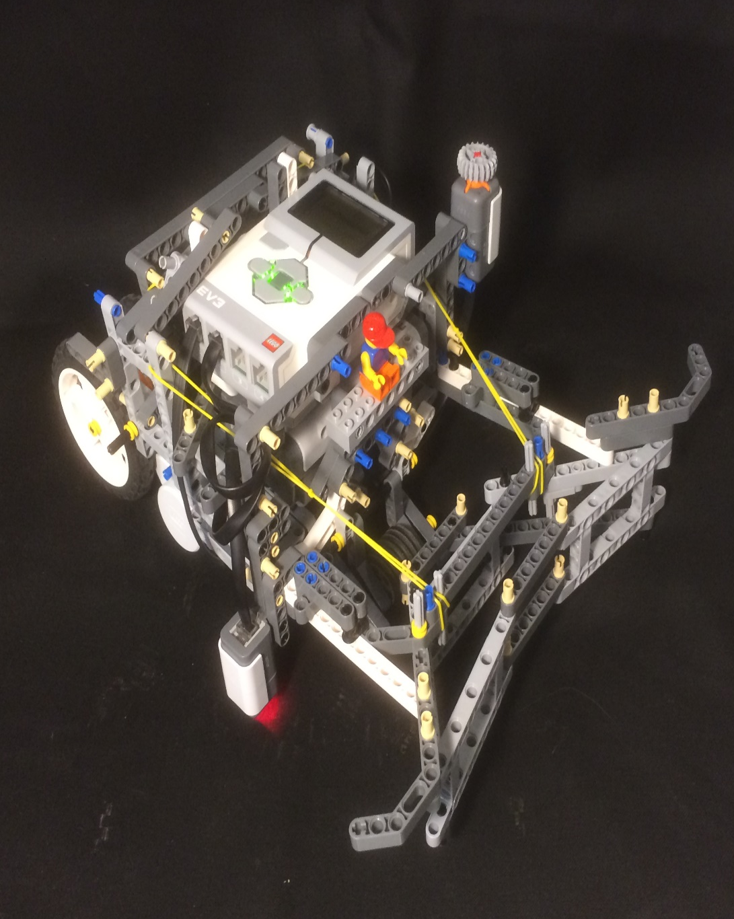
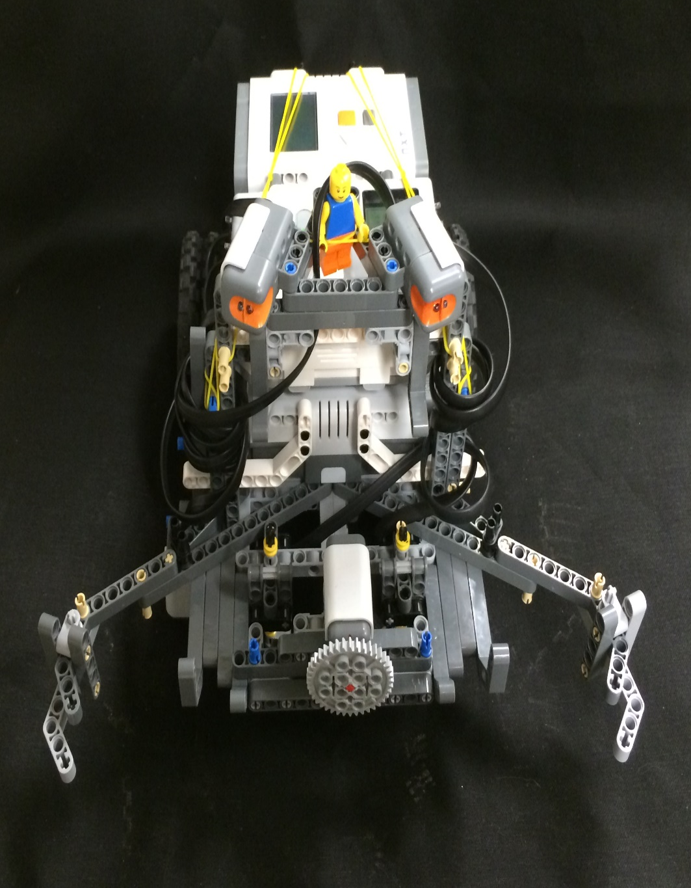
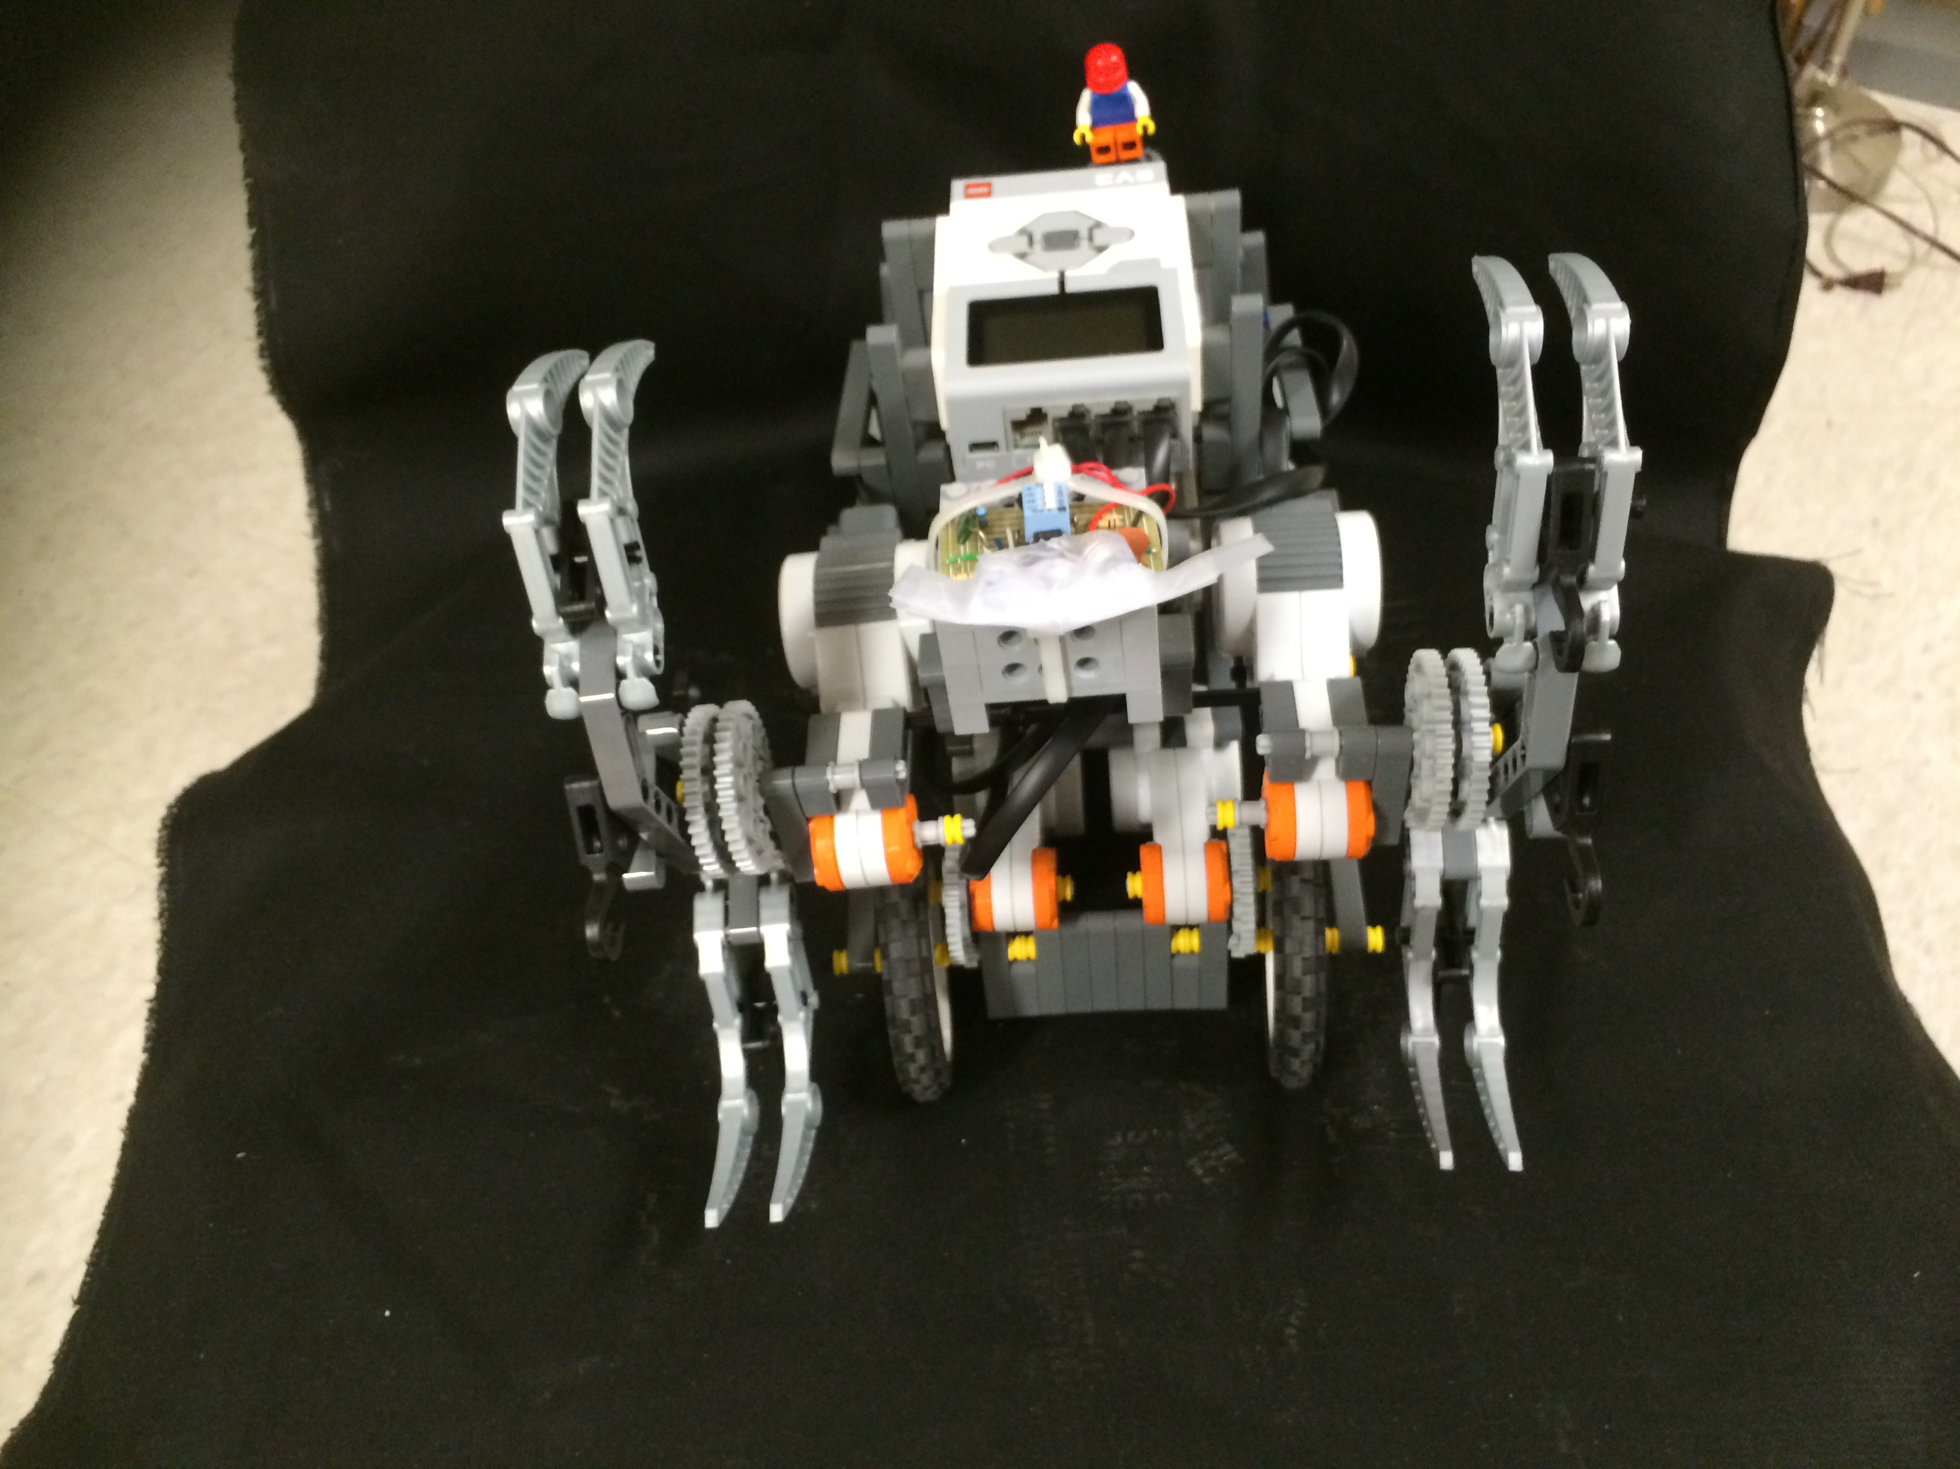
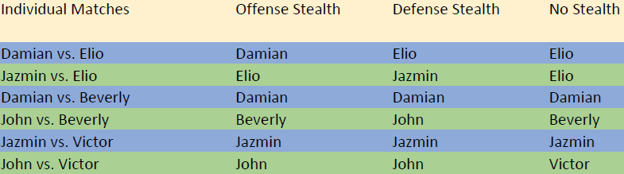
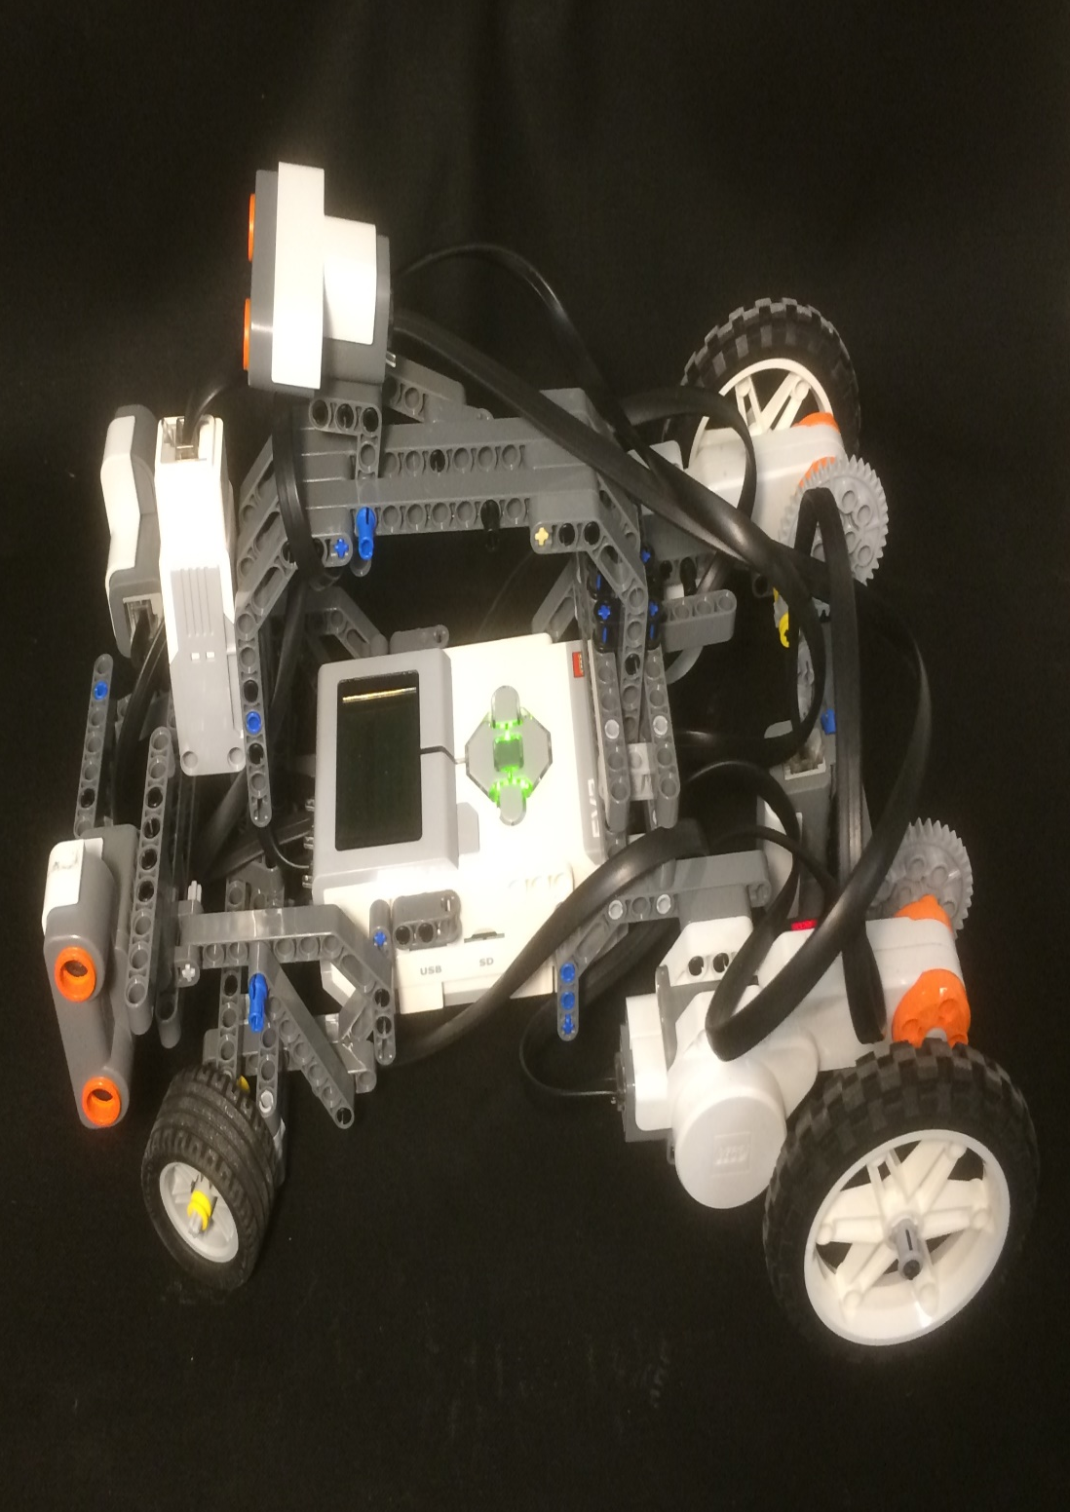
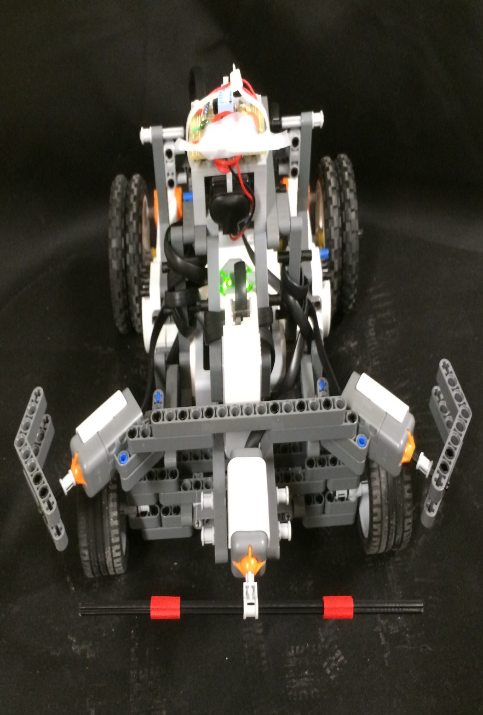
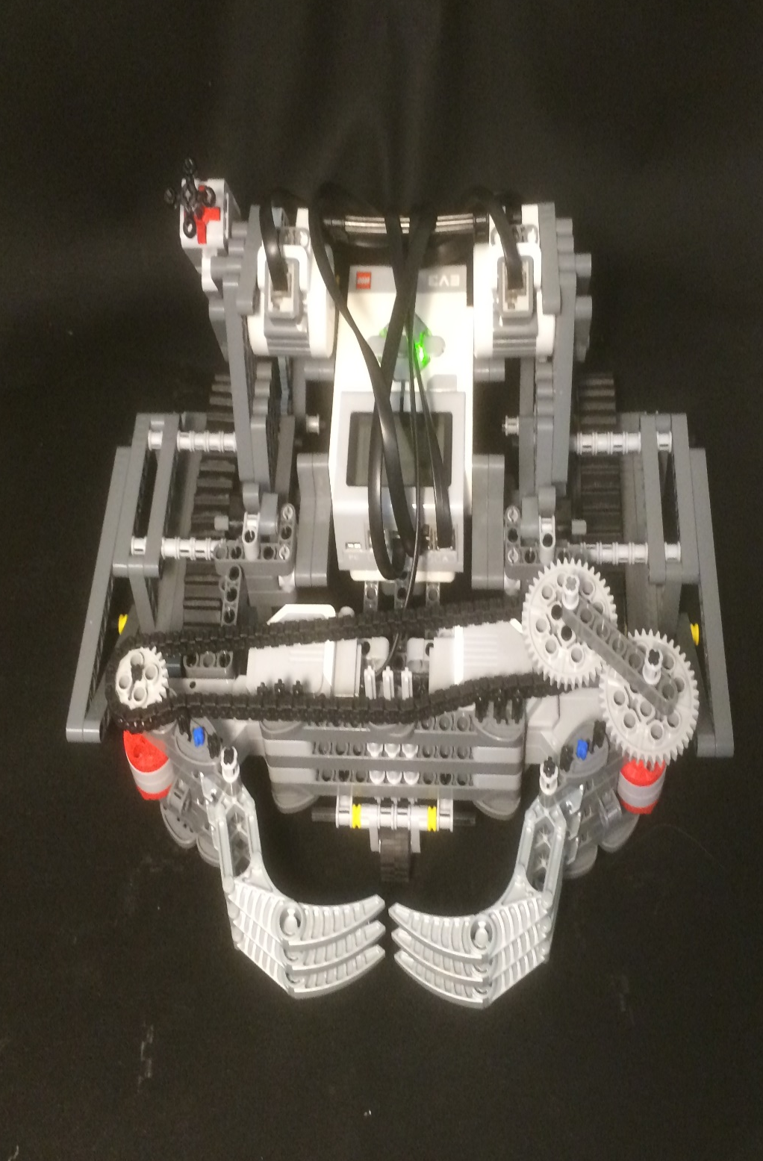
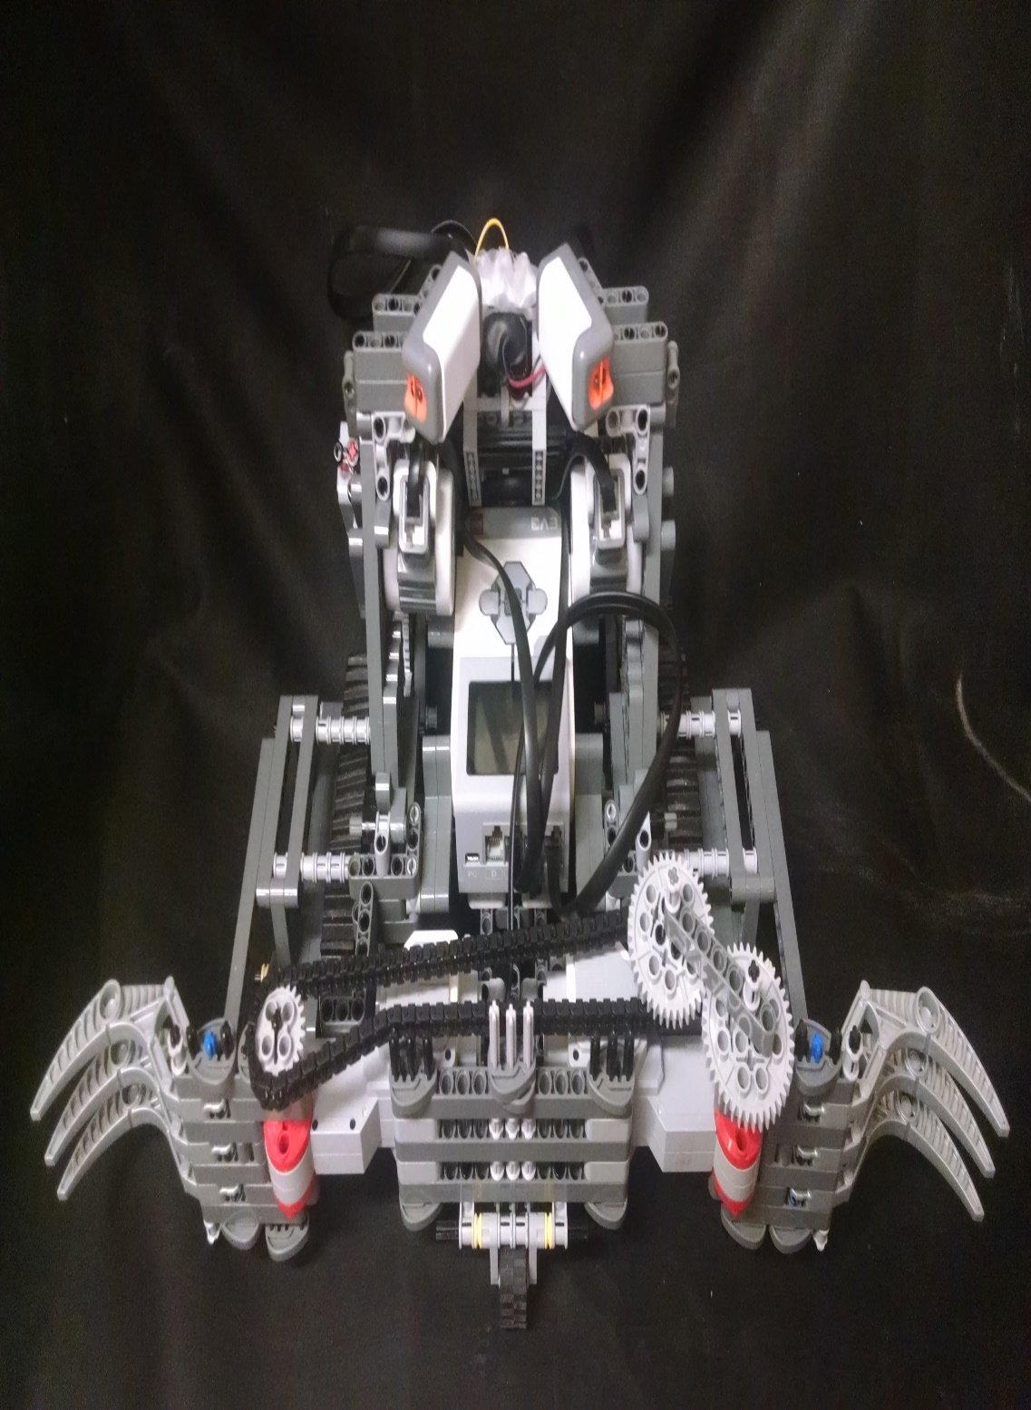
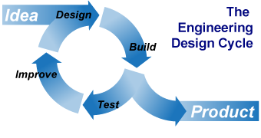
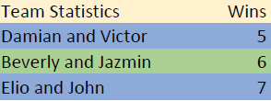
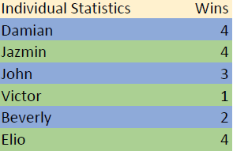
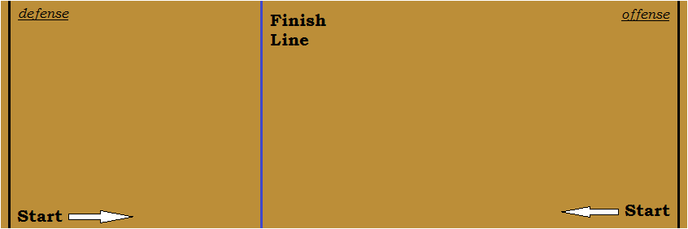
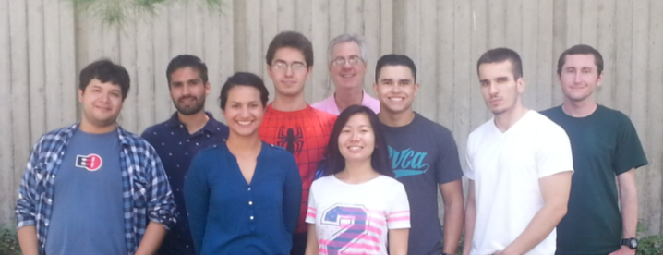
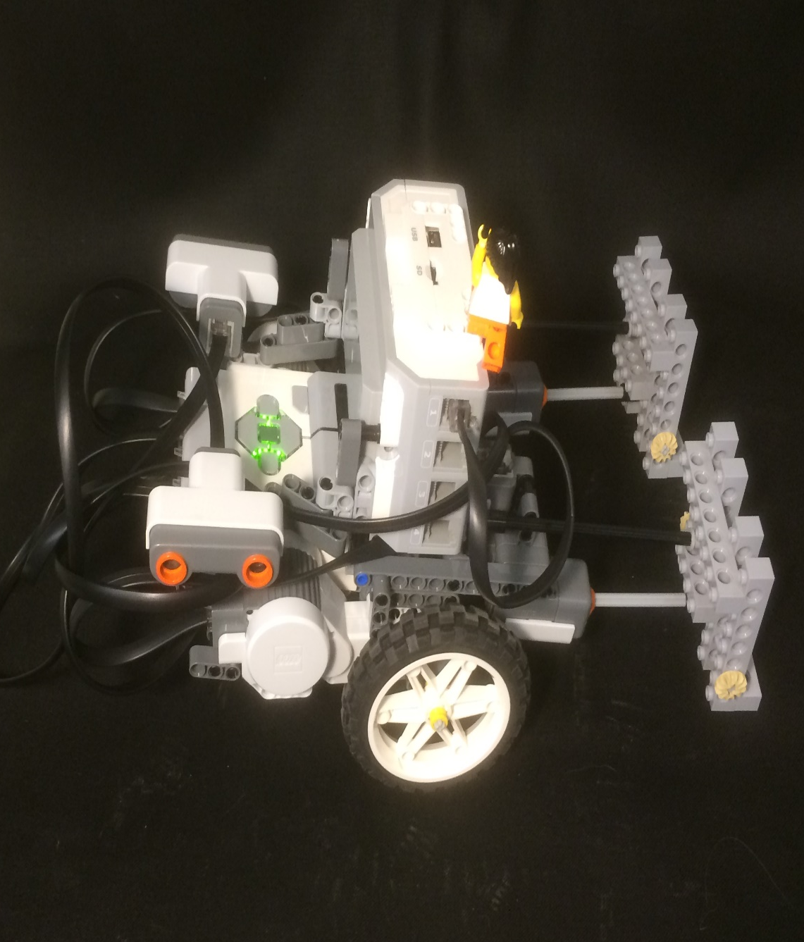
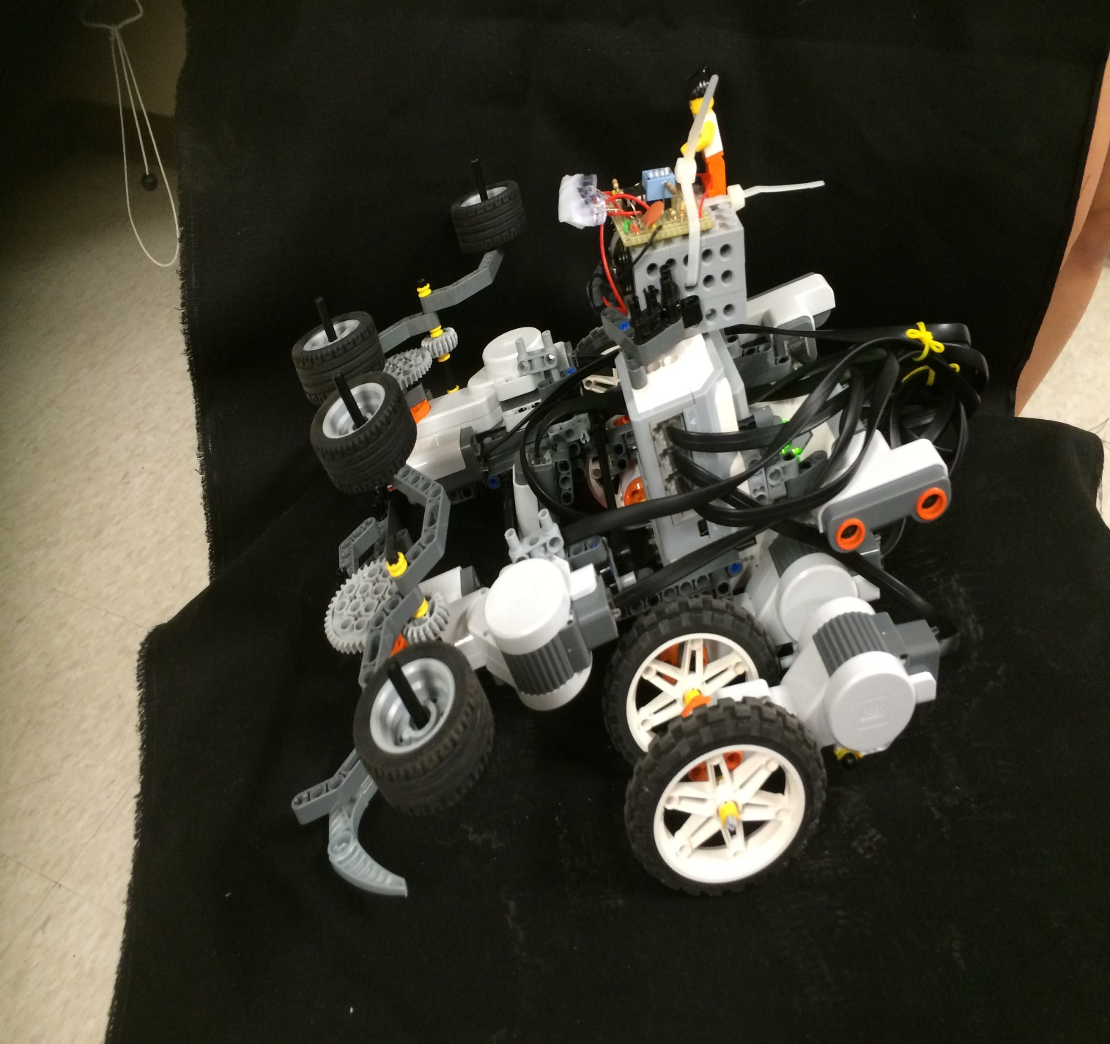
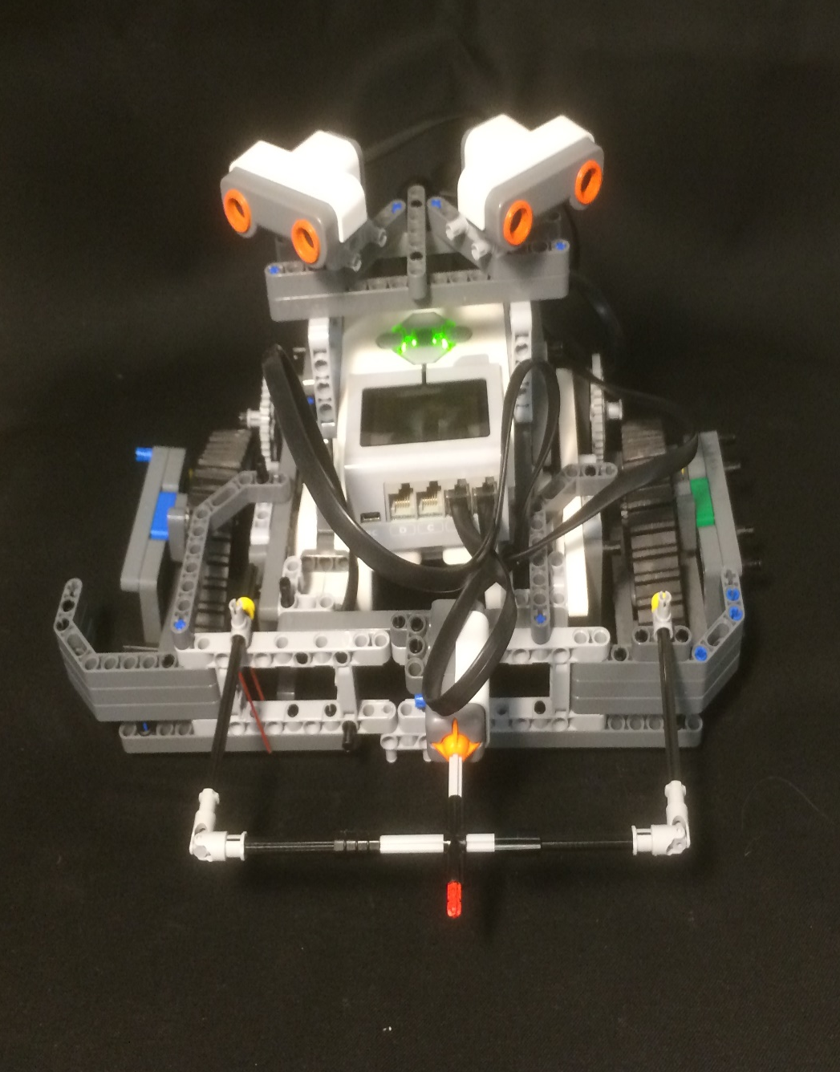
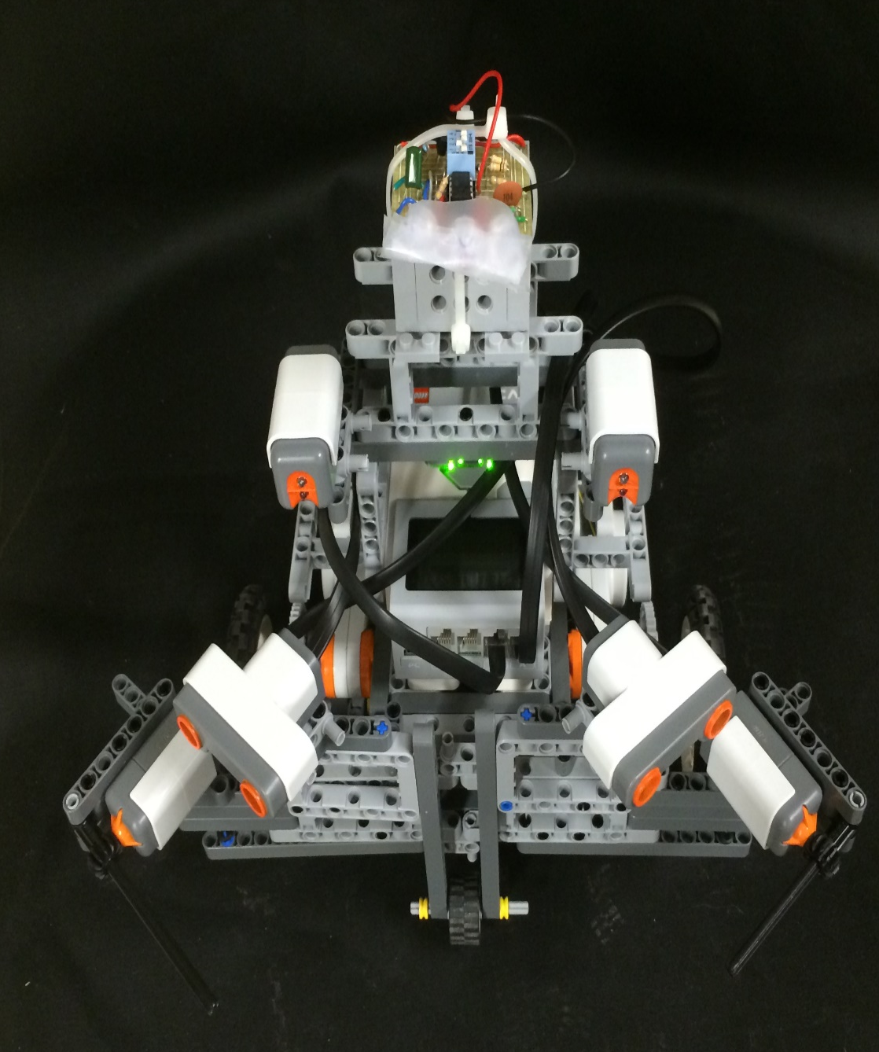
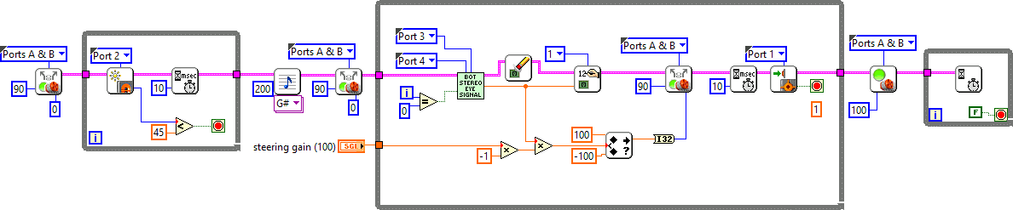
Autonomous Robot War
Jazmin Garcia, Beverly Abadines, Elio Gonzalez,
John Carter, Damian Montes, Victor Garcia, mentors: Juan Nevares, Nicholas Valentine, and Dr. Paul K. Dixon
Overview
There are two categories of robots: offensive and defensive. Six robots were made; three of each. There are three teams; each team with one of each type of robot. The battlefield is an alleyway with walls on each side and a blue finish line in between. The goal of the offensive robot is to cross the finish line. The goal of the defensive robot is to prevent the offensive robot from crossing that line. None of the robots are allowed to be remote controlled. They must be programmed to do it themselves, autonomously. The robots were periodically tested and improved accordingly. The final results are displayed.
Victor Garcia Robot name: VAF
Damian Montes
Robot name: Krabby
Conclusion
Naturally, the robots underwent iterative design development in an effort to bolster featured strengths, and contrarily, to correct exhibited weaknesses from each battle. It was a progressive competition that combined theory and practice in order to produce not necessarily, the largest, strongest, fastest, and smartest robot, but simply the creation that can achieve the goal of crossing or protecting the blue line most efficiently and flawlessly.
Original
Final
Original
Final
Original
Design Purpose: Offense
• Speed
• Lifting the opposing robot
• Weight for traction
Design Conflicts
• Battery dies extremely fast
• Structure often would cause defects
Design Purpose: Defense
Strong to withstand hits
Wide Bumper
Multiple motors
Heavy
Design Conflicts
Steering capabilities
• Light sensor detection
• Medium speed
Elio Gonzalez Robot name: Lucy
John Carter Robot Name: Ethel
Original
Final
Original
Final
Design Purpose: Offense
• Speed
• Lightweight
• Stability
• Maneuverability
Design Conflicts
Reduced torque
Independent Steering
Response Faulty
Gear Slippage
Design Purpose: Defense
Expands to block path
Heavy weight for traction
Strong structure for collisions
Design Conflict
Too large
Difficulty turning
Too heavy
Slow speed
LabVIEW
All the coding we did for the Lego EV3 robots was done through the LabVIEW software. LabVIEW is a coding program that uses icons with specified functions and values that wire to each other to make the program run, rather than normal text coding. LabVIEW allowed us to use the robot’s touch sensors, light sensors, and motors to fulfill the tasks assigned.
Beverly Abadines Robot name: Bev Jr.
Jazmin Garcia Robot name: Eve
Acknowledgements
Thank you for your guidance and expertise…
• Dr. Paul K. Dixon, Department of Physics, CSUSB
• Dr. Rolland Trapp, Department of Mathematics, CSUSB
• Nicholas Valentine and Juan Nevares, undergraduate mentors, CSUSB
• And for making this research possible…
• The National Science Foundation
• M&M’s and Skittles
Original
Final
Original
Final
Design Purpose: Offense
• Maneuverability
• Wheels of Death
• Strength
• Overloaded sensors
Design Conflicts
• Delay in communication
• Limited attack range
• Weak sensor sensitivity
Design Purpose: Defense
Withstand hits
Sense opponent with light and sonar sensors
Ram into opponent
Design Conflicts
Weak sonar sensor range
Difficult steering
Sponsored by the National Science Foundation

